Slide 1
Chapter 1 Introduction to Java & Chapter 2 Elementary Programming

Slide 2
Objectives
To explain the basic syntax of a Java program.
To use sound Java programming style and document programs properly.
To explain the differences between syntax errors, runtime errors, and logic errors.
To create, compile, and run Java programs using NetBeans.

Slide 3
Programming Languages
Machine Language Assembly Language High-Level Language
Machine language is a set of primitive instructions built into every computer. The instructions are in the form of binary code, so you have to enter binary codes for various instructions. Program with native machine language is a tedious process. Moreover the programs are highly difficult to read and modify. For example, to add two numbers, you might write an instruction in binary like this:
1101101010011010

Slide 4
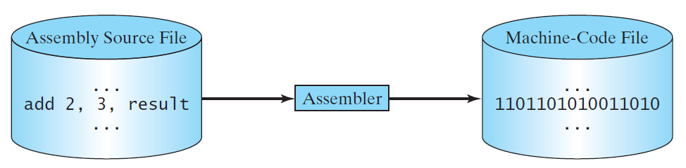
Programming Languages
Machine Language Assembly Language High-Level Language
Assembly language is a much more readable rendition of machine language and uses mnemonic codes to refer to machine code instructions, rather than using the instructions' numeric values directly.
Microsoft Macro Assembler (MASM) is an x86 assembler.
Since the computer cannot understand assembly language, however, a program called assembler is used to convert assembly language programs into machine code. For example, to add two numbers, you might write an instruction in assembly code like this:
ADD R1, R2, R3

Slide 5
Programming Languages
Machine Language Assembly Language High-Level Language
The high-level languages are English-like and easy to learn and program. For example, the following is a high-level language statement that adds two numbers: result = 2 + 3;
A program written in a high-level language is called a source program or source code. Because a computer cannot understand a source program, a source program must be translated into machine code for execution. The translation can be done using another programming tool called an interpreter or a compiler.

Slide 6
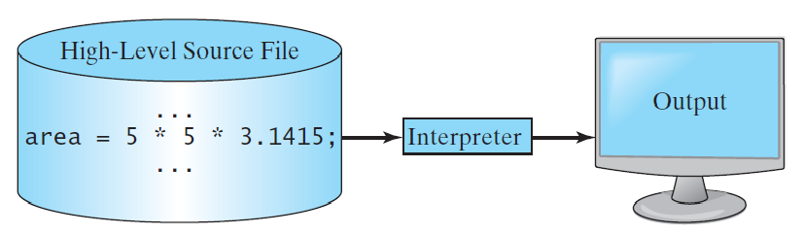
Interpreting Source Code
An interpreter reads one statement from the source code, translates it to the machine code, and then executes it right away. Note that a statement from the source code may be translated into several machine instructions.
Examples: Perl, Python, MATLAB, Ruby

Slide 7
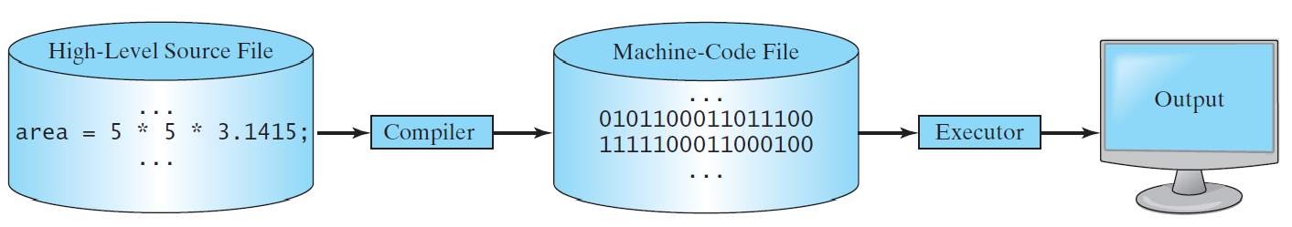
Compiling Source Code
A compiler translates the entire source code into a machine-code file, and the machine-code file is then executed, as shown in the following figure.

Slide 8
Popular High-Level Languages

Slide 9
Java’s History
James Gosling and Sun Microsystems in 1991
Originally called Oak
Renamed to Java in 1995
HotJava
The first Java-enabled Web browser, 1997
Sun Microsystems purchased by Oracle in 2010
Early History Website:
http://www.java.com/en/javahistory/index.jsp

Slide 10
Why Java?
Java Is Simple
Java Is Object-Oriented
Java Is Distributed
Java Is Interpreted
Java Is Robust
Java Is Secure
Java Is Architecture-Neutral
Java Is Portable
Java's Performance
Java Is Multithreaded
Java Is Dynamic

Slide 11
Characteristics of Java
Java Is Simple
Java Is Object-Oriented
Java Is Distributed
Java Is Interpreted
Java Is Robust
Java Is Secure
Java Is Architecture-Neutral
Java Is Portable
Java's Performance
Java Is Multithreaded
Java Is Dynamic
Java is partially modeled on C++, but greatly simplified and improved. Some people refer to Java as "C++--" because it is like C++ but with more functionality and fewer negative aspects.

Slide 12
Characteristics of Java
Java Is Simple
Java Is Object-Oriented
Java Is Distributed
Java Is Interpreted
Java Is Robust
Java Is Secure
Java Is Architecture-Neutral
Java Is Portable
Java's Performance
Java Is Multithreaded
Java Is Dynamic
Java is inherently object-oriented. Although many object-oriented languages began strictly as procedural languages, Java was designed from the start to be object-oriented. Object-oriented programming (OOP) is a popular programming approach that is replacing traditional procedural programming techniques.
One of the central issues in software development is how to reuse code. Object-oriented programming provides great flexibility, modularity, clarity, and reusability through encapsulation, inheritance, and polymorphism.

Slide 13
Characteristics of Java
Java Is Simple
Java Is Object-Oriented
Java Is Distributed
Java Is Interpreted
Java Is Robust
Java Is Secure
Java Is Architecture-Neutral
Java Is Portable
Java's Performance
Java Is Multithreaded
Java Is Dynamic
Java is designed to make distributed computing easy which involves several computers working together on a network. Since networking capability is inherently integrated into Java, writing network programs is like sending and receiving data to and from a file.

Slide 14
Characteristics of Java
Java Is Simple
Java Is Object-Oriented
Java Is Distributed
Java Is Interpreted
Java Is Robust
Java Is Secure
Java Is Architecture-Neutral
Java Is Portable
Java's Performance
Java Is Multithreaded
Java Is Dynamic
You need an interpreter to run Java programs. The programs are compiled into the Java Virtual Machine code called bytecode. The bytecode is machine-independent and can run on any machine that has a Java interpreter, which is part of the Java Virtual Machine (JVM).

Slide 15
Characteristics of Java
Java Is Simple
Java Is Object-Oriented
Java Is Distributed
Java Is Interpreted
Java Is Robust
Java Is Secure
Java Is Architecture-Neutral
Java Is Portable
Java's Performance
Java Is Multithreaded
Java Is Dynamic
Robust simply means strong. Java is robust because:
It uses strong memory management.
There is a lack of pointers that avoids security problems.
There is automatic garbage collection in java which runs on the Java Virtual Machine to get rid of objects which are not being used by a Java application anymore.
There are exception handling and the type checking mechanism in Java. All these points make Java robust.

Slide 16
Characteristics of Java
Java Is Simple
Java Is Object-Oriented
Java Is Distributed
Java Is Interpreted
Java Is Robust
Java Is Secure
Java Is Architecture-Neutral
Java Is Portable
Java's Performance
Java Is Multithreaded
Java Is Dynamic
Java implements several security mechanisms to protect your system against harm caused by stray programs.

Slide 17
Characteristics of Java
Java Is Simple
Java Is Object-Oriented
Java Is Distributed
Java Is Interpreted
Java Is Robust
Java Is Secure
Java Is Architecture-Neutral
Java Is Portable
Java's Performance
Java Is Multithreaded
Java Is Dynamic
Java is “Write once, run anywhere” language.
Java code is compiled by the compiler and converted into bytecode. This bytecode is a platform-independent code because it can be run on multiple platforms, i.e., Write Once and Run Anywhere(WORA).

Slide 18
Characteristics of Java
Java Is Simple
Java Is Object-Oriented
Java Is Distributed
Java Is Interpreted
Java Is Robust
Java Is Secure
Java Is Architecture-Neutral
Java Is Portable
Java's Performance
Java Is Multithreaded
Java Is Dynamic
Because Java is architecture neutral, Java programs are portable. They can be run on any platform without being recompiled.

Slide 19
Characteristics of Java
Java Is Simple
Java Is Object-Oriented
Java Is Distributed
Java Is Interpreted
Java Is Robust
Java Is Secure
Java Is Architecture-Neutral
Java Is Portable
Java's Performance
Java Is Multithreaded
Java Is Dynamic
Java is faster than other traditional interpreted programming languages because Java bytecode is "close" to native code.

Slide 20
Characteristics of Java
Java Is Simple
Java Is Object-Oriented
Java Is Distributed
Java Is Interpreted
Java Is Robust
Java Is Secure
Java Is Architecture-Neutral
Java Is Portable
Java's Performance
Java Is Multithreaded
Java Is Dynamic
A thread is like a separate program, executing concurrently. We can write Java programs that deal with many tasks at once by defining multiple threads.

Slide 21
Characteristics of Java
Java Is Simple
Java Is Object-Oriented
Java Is Distributed
Java Is Interpreted
Java Is Robust
Java Is Secure
Java Is Architecture-Neutral
Java Is Portable
Java's Performance
Java Is Multithreaded
Java Is Dynamic
Java supports dynamic loading of classes, dynamic compilation and automatic memory management

Slide 22
JDK
The Java Development Kit (JDK) is a package of tools for developing Java-based software.
The first version JDK 1.0 was released on January 23, 1996. The latest is Java SE 13 from Sept. 2019.
JDK comes in three different packages:
Java Enterprise Edition (Java EE) to develop server-side applications such as Java servlets, Java ServerPages, and Java ServerFaces,
Java Standard Edition (Java SE) to develop client-side standalone applications or applets, and
Java Mobile Edition (Java ME) to develop applications for mobile devices.
We use Java SE to develop desktop applications and can be freely download from: https://www.oracle.com/technetwork/java/javase/downloads/index.html

Slide 23
Popular Java IDEs
An Integrated Development Environment (IDE) is an application which facilitates the application development.
NetBeans
Eclipse
JDeveloper
And several others….

Slide 24
A Simple Java Program
Listing 1.1
// This program prints Welcome to Java!
public class Welcome {
public static void main(String[] args) {
System.out.println("Welcome to Java!");
}
}
Animation
System is a class in the java.lang package .
The out is a static member of the System class, and is an instance of java.io.PrintStream.
The println is a method of java.io.PrintStream.
Welcome
Run

Slide 25
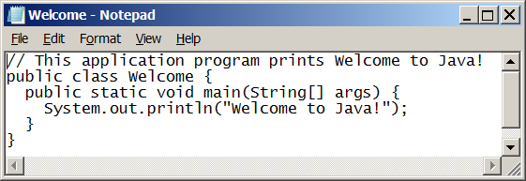
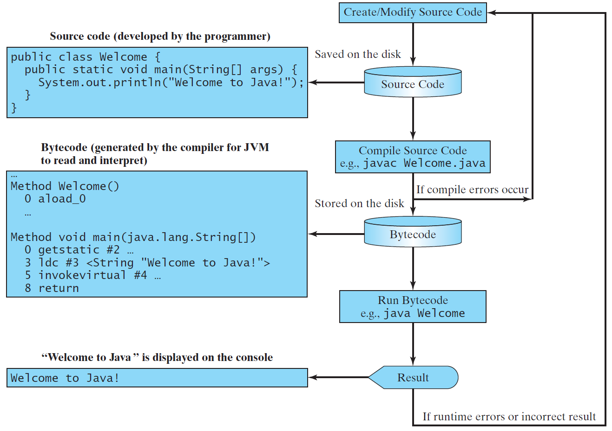
Creating, Compiling, and Running Programs

Slide 26
Programming Style
Appropriate Comments
Naming Conventions
Proper Indentation and Spacing Lines
Block Styles

Slide 27
Programming Errors
Syntax Errors
Detected by the compiler
System.out.println("Welcome to Java);
Runtime Errors
Causes the program to abort
System.out.println(1 / 0);
Logic Errors
Produces incorrect result
System.out.println(“The average is“ + (a+b/2));

Slide 28
Identifiers
Identifiers are the names that identify the elements such as classes, methods, and ­variables in a program.
An identifier is a sequence of characters that consist of letters, digits, underscores (_), and dollar signs ($).
An identifier must start with a letter, an underscore (_), or a dollar sign ($). It cannot start with a digit. Even though it is allowed, you do not normally start a Java variable name with $ or _ .
An identifier cannot be a reserved word.
An identifier cannot be true, false, or null.
An identifier can be of any length.

Slide 29
Naming Conventions
Choose meaningful and descriptive names.
Variables and method names:
Use lowercase. For example, the variables radius and area, and the method computeArea().
Class names:
Capitalize the first letter of each word in the name. For example, the class name GraduateStudent.
Constants:
Capitalize all letters in constants and use underscores to connect words. For example, the constant PI and MAX_VALUE

Slide 30
Named Constants
final datatype CONSTANTNAME = VALUE;
final double PI = 3.14159;
final int SIZE = 3;

Slide 31
Numerical Data Types

Slide 32
Numeric Operators
5 / 2 yields an integer 2.
5.0 / 2 yields a double value 2.5
5 % 2 yields 1 (the remainder of the division)

Slide 33
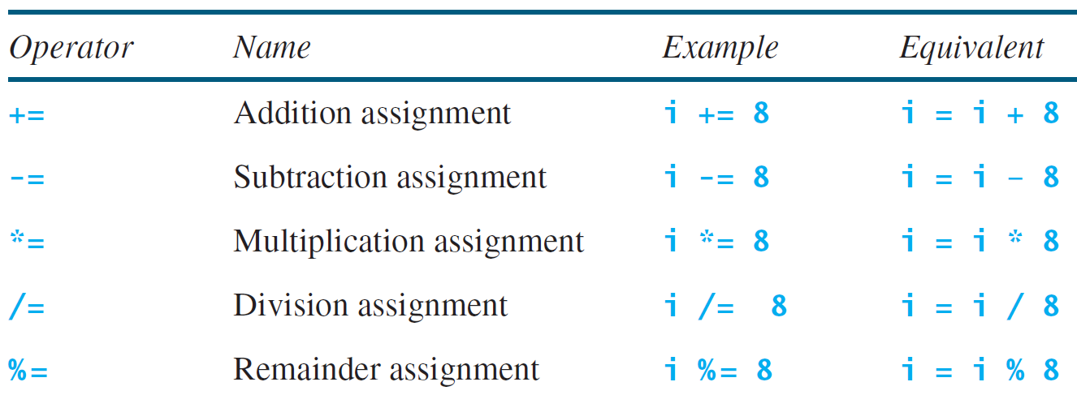
Augmented Assignment Operators

Slide 34
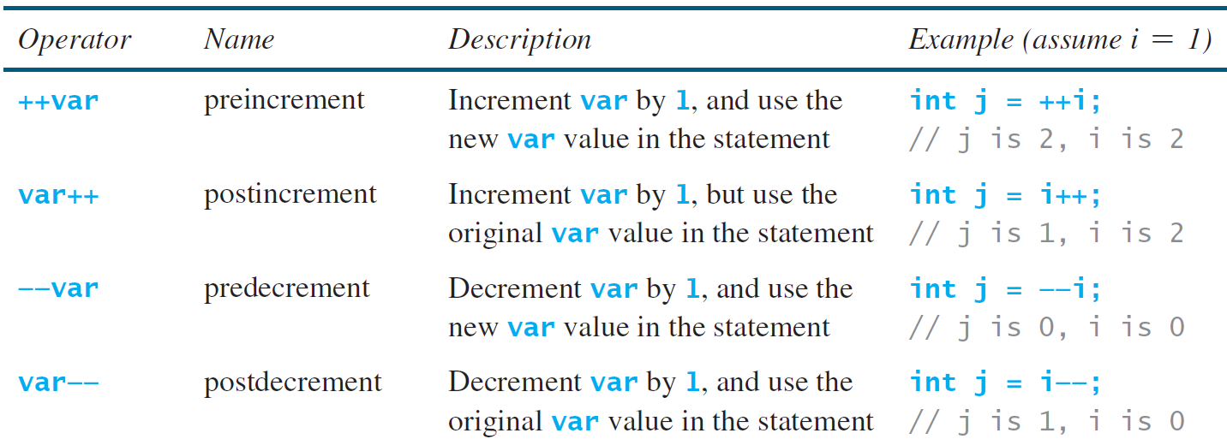
Increment and Decrement Operators
int a =5;
System.out.println(a++);
System.out.println(a);
System.out.println(++a);
System.out.println(a);

Slide 35
Type Casting
Implicit casting
double d = 3; (type widening)
Explicit casting
int i = (int)3.0; (type narrowing)
int i = (int)3.9; (Fraction part is truncated)

Slide 36
Reading Numbers from the Keyboard
You will need to create an object of Scanner class.
import java.util.Scanner;
Scanner input = new Scanner(System.in);
int value = input.nextInt();
Animation
ComputeAreaWithConsoleInput
ComputeAverage
Run
Run

Slide 37
Problem: Displaying Current Time
Write a program that displays current time in GMT in the format hour:minute:second such as 12:45:19.
The currentTimeMillis method in the System class returns the total number of milliseconds elapsed since the midnight, January 1, 1970 GMT. (1970 was the year when the Unix operating system was formally introduced.) You can use this method to obtain the current time, and then compute the current second, minute, and hour as follows.
ShowCurrentTime
Run

Slide 38
Problem: Monetary Units
This program lets the user enter the amount in decimal representing dollars and cents and output a report listing the monetary equivalent in single dollars, quarters, dimes, nickels, and pennies. Your program should report maximum number of dollars, then the maximum number of quarters, and so on, in this order.
ComputeChange
Run

Slide 39
Practice Exercise
Body Mass Index (BMI) is a measure of health on weight. It can be calculated by taking your weight in kilograms and dividing, by the square of your height in meters.
Write a program that prompts the user to enter a weight in pounds and height in inches and displays the BMI. Note one pound is 0.45359237 kilograms and one inch is 0.0254 meters.
Here is a sample run:
Enter weight in pounds: 95.5
Enter height in inches: 50
BMI is 26.8573

